Slide 1
MANAGEMENT SYSTEM FOR REGAL HARDWARE

Slide 2
GROUP MEMBERS
1. W.M AFRIDH
2. P.B KODITHUWAKKU
3. D.M.D.R.B DISSANAYAKA
4. R.M.C.H RATHNAYAKA
5. D.M.S.B DISSANAYAKA
6. E.M JAYARATHNA
7. M.N.N AHAMED
8. R.M.V.D.B RATHNAYAKA
9. N.G.W.P PIYASOMA

Slide 3
INTRODUCTION ABOUT CLIENT
I am Wazeer (L.T.J)
I am the Owner Of Regal Hardware
I have many branches to my shop
I wish to better manage my store and expanding branch Locations
I am getting older , So I wish to make managing my stores in a less exhausting manner

Slide 4
REQUIREMENTS OF CLIENT
I want an Employee management system.
I want a Transport management system.
I want an automated P.O.S. system.
I want a branch management system.

Slide 5
Our System Has The Following Functions
1. Employee Management
2. Supplier Management
3. Inventory Management
4. Restocking
5. Packaging
6. Sales
7. Customer Management
8. Branch Management
9. Transport Management

Slide 6
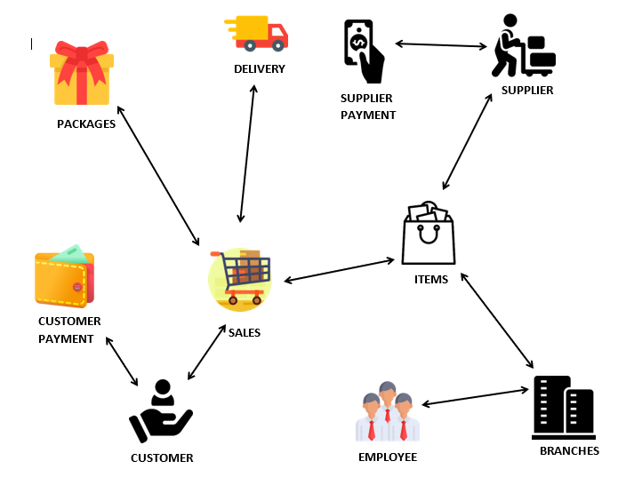
Overview Diagram

Slide 7



Our System Technologies
BACKEND
FRONTEND
BACKEND

Slide 8


Banuka Kodituwakku
Employee Management

Slide 9
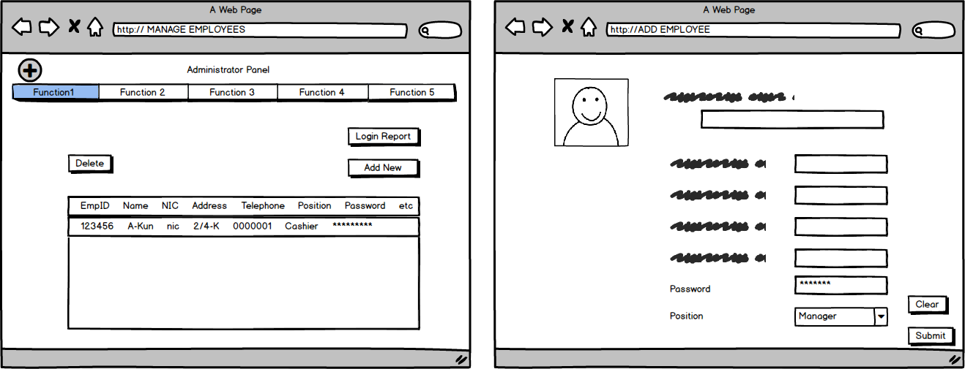
Employee Management

Slide 10
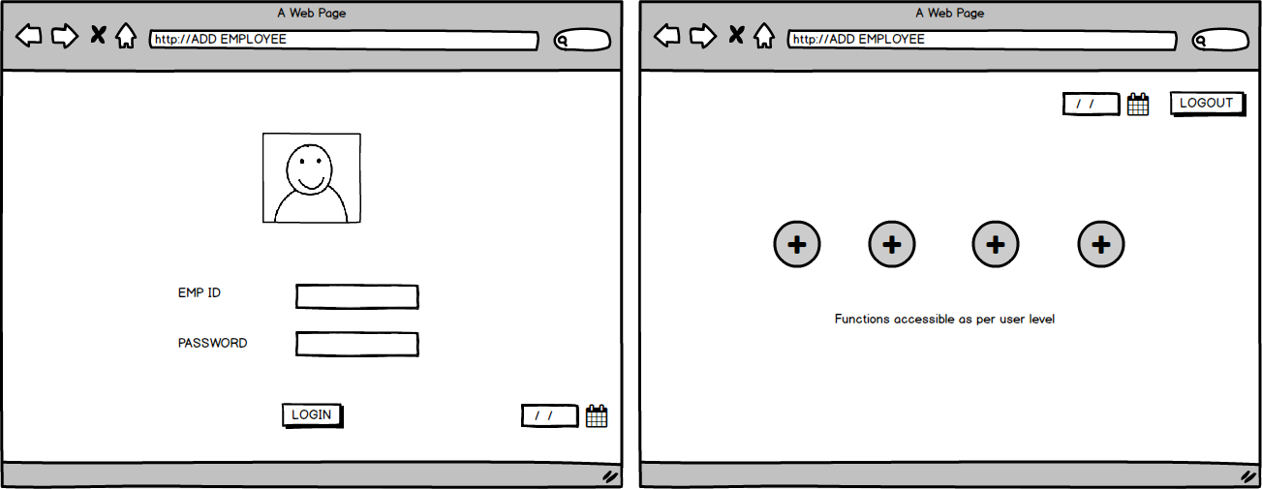
Employee Management

Slide 11


Sanjaya Dissanayake
Supplier Management

Slide 12
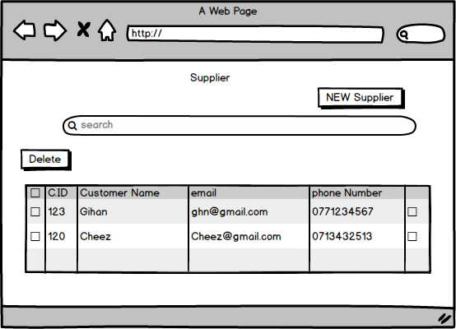
Supplier Management

Slide 13
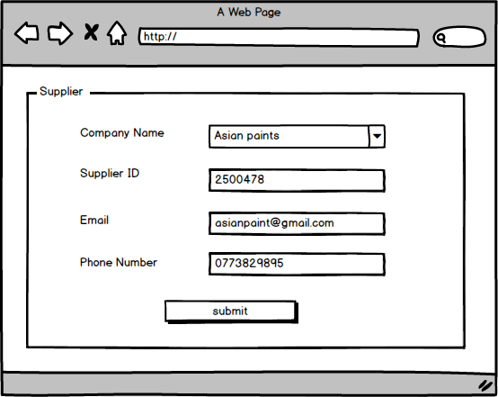
Supplier Management

Slide 14
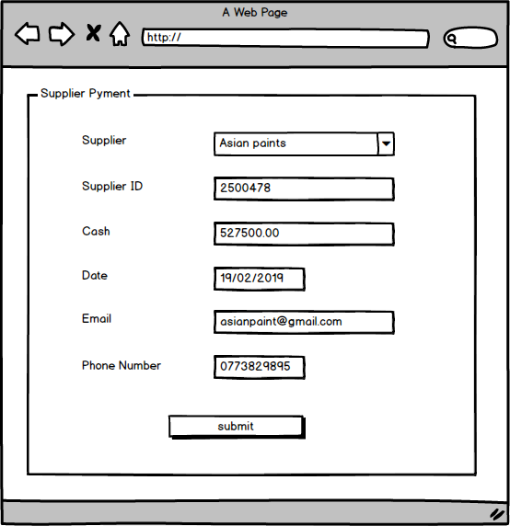
Supplier Management

Slide 15


Afridh Wazeer
Inventory Management

Slide 16
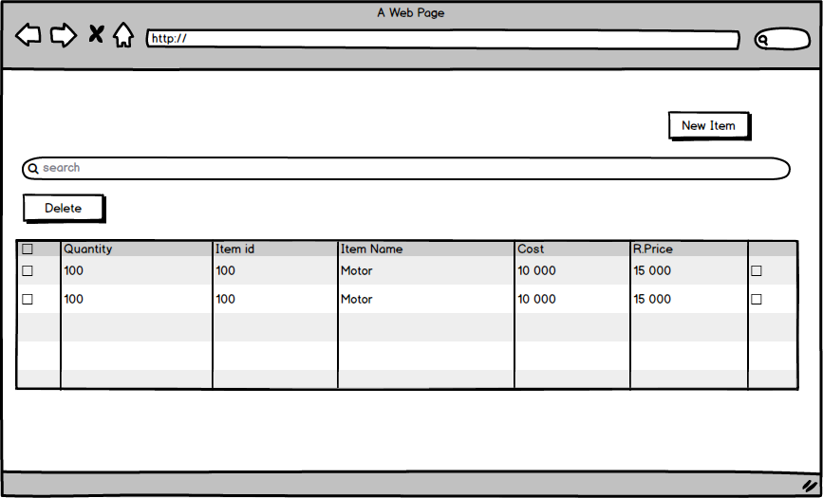
Inventory Management

Slide 17
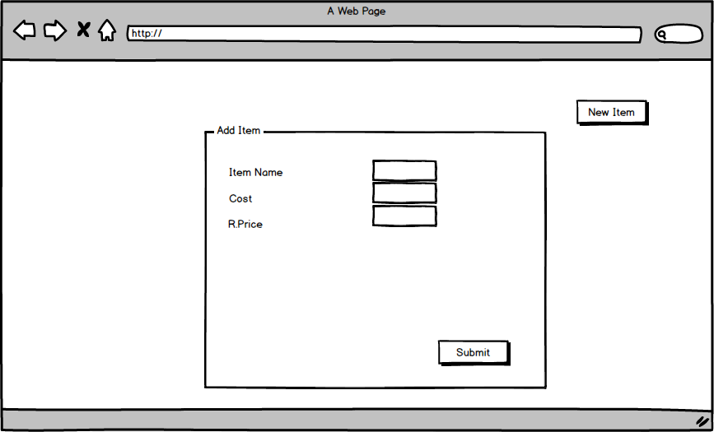
Inventory Management

Slide 18


Eshan Jayarathna
Restocking

Slide 19
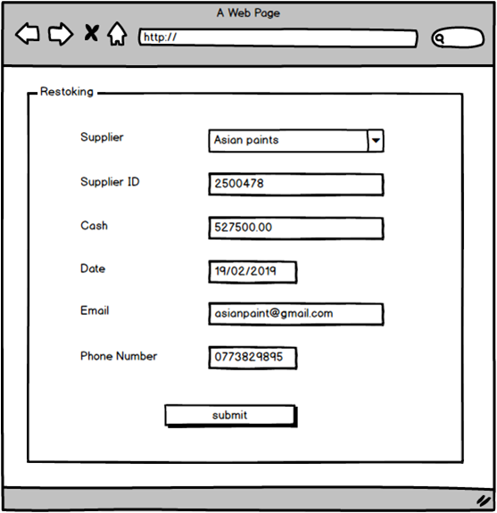
Restocking

Slide 20
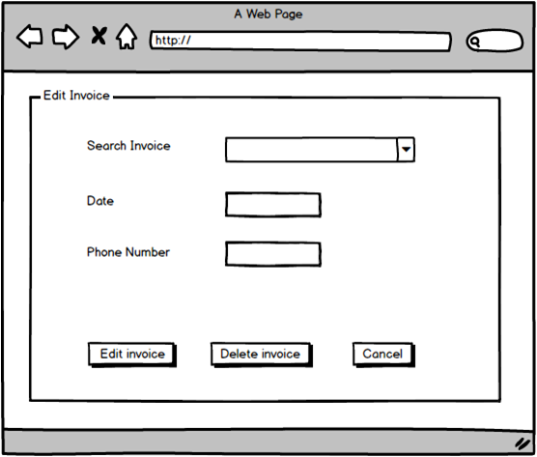
Restocking

Slide 21


Waruni Priyanwada Piyasoma
Package Management

Slide 22
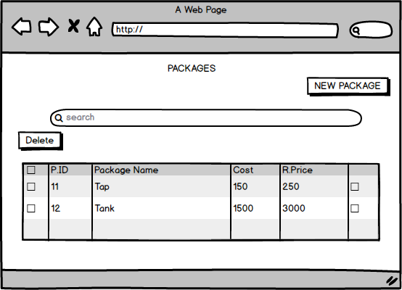
Package Management

Slide 23
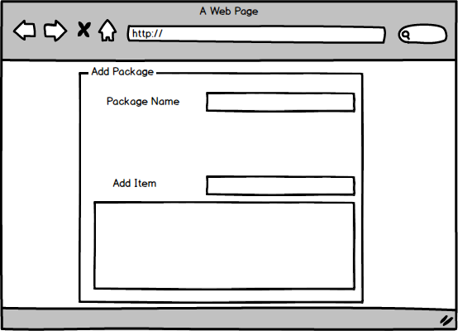
Package Management

Slide 24


Nusky Ahamed
Sales

Slide 25
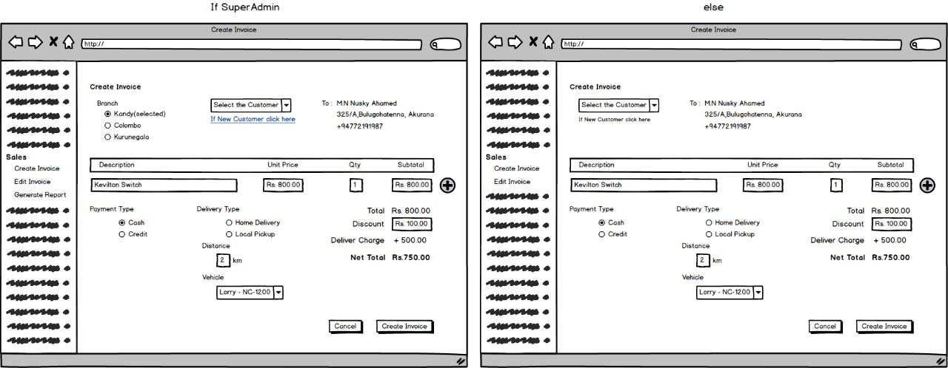
Sales

Slide 26
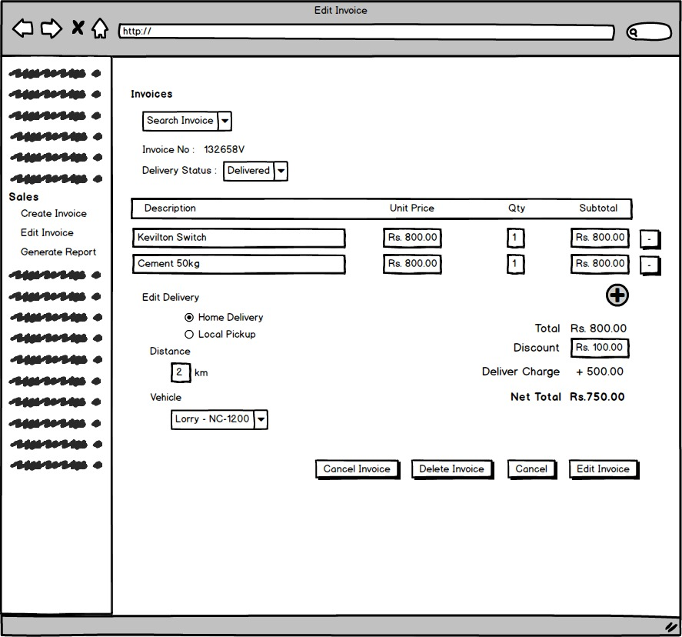
Sales

Slide 27
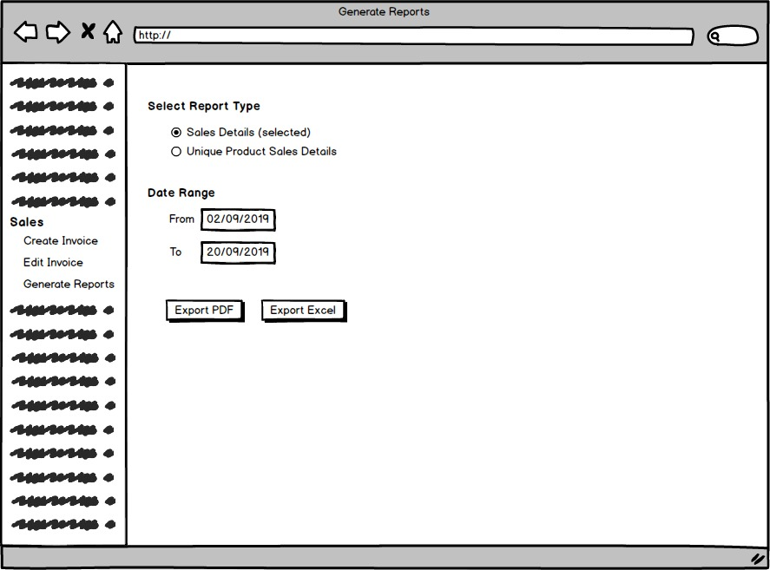
Sales

Slide 28


Hansi Rathnayaka
Customer Management

Slide 29
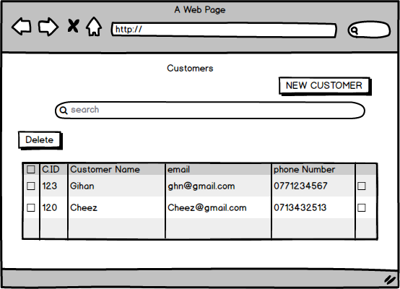
Customer Management

Slide 30
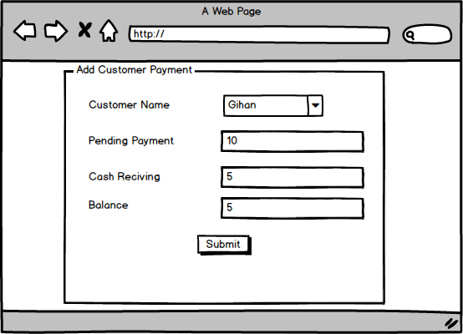
Customer Management

Slide 31


Ravidu Dissanayake
Branch Management

Slide 32
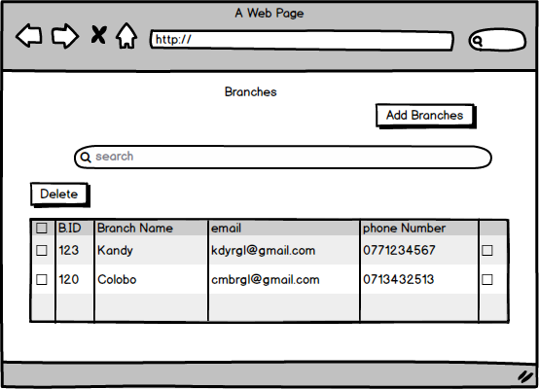
Branch Management

Slide 33
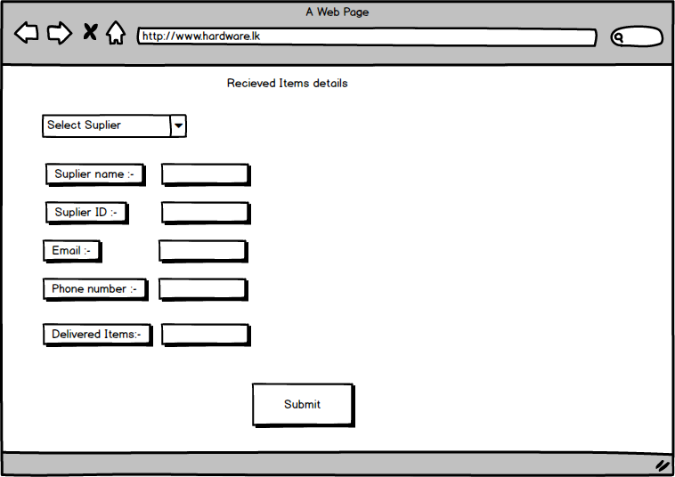
Branch Management

Slide 34


Vidura Deshan
Transport Management

Slide 35
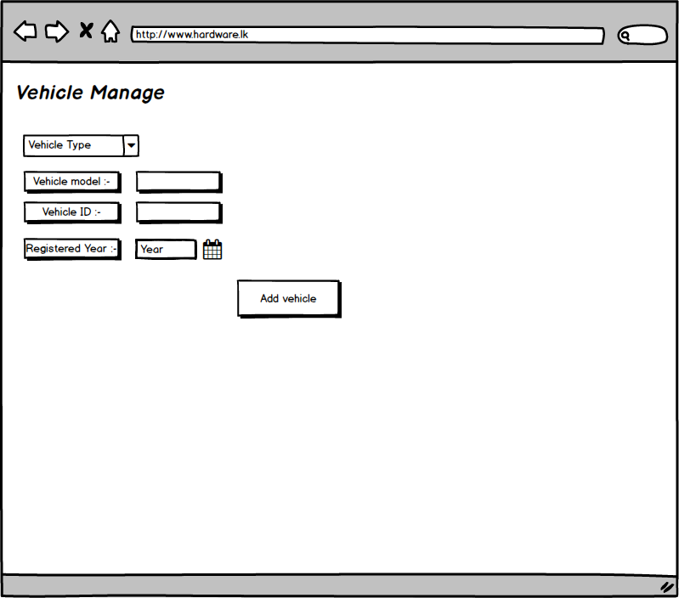
Transport Management

Slide 36
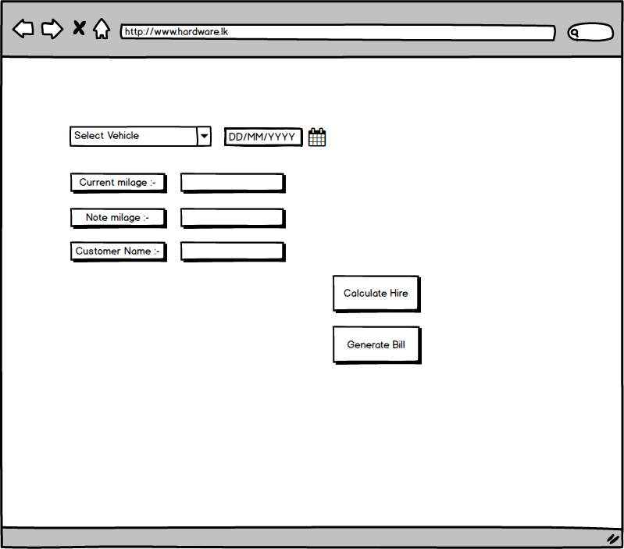
Transport Management

Slide 37
THANK YOU

